Slide 1
Corpus linguistics an introduction

Slide 2
Key points
Basic notions
historical development: two competing approaches
Types of corpus
Exploiting a corpus
Resources

Slide 3
Basic notions
Corpus: A collection of naturally occurring language text, chosen to characterise a state or variety of language (Sinclair)
A collection of linguistic data, either written text or a transcription of recorded data, which can be used as starting-point of linguistic description or as a means of verifying hypotheses about a language (Dictionary of linguistics and phonetics)

Slide 4
What is a corpus?
Large body of evidence typically composed of attested language use (McEnery)
Usually a corpus is in machine-readable format and is ideally viewable and analysable through (a single) software package
The word corpus comes from Latin body and the plural is corpora

Slide 5
“If it happens once, you don't know anything. If it happens twice, it suggests further investigation. If it happens three or more times, then you have something to write about!”

Slide 6
History
We have to split the history in two periods: before Chomsky and after Chomsky
Before Chomsky, methods similar to the ones in corpus linguistics were used (empiricism) http://www.ling.lancs.ac.uk/monkey/ihe/linguistics/corpus1/1fra1.htm

Slide 7
Early corpus linguistics
Before Chomsky
Computers were not available so it was difficult to analyse large collections of text
Studies of child language using diaries kept by parents
Spelling conventions in a German corpus of 11 million words
Foreign language pedagogy

Slide 8
Early corpus linguistics (II)
All the work of early corpus linguistics was underpinned by two fundamental, yet flawed assumptions:
The sentences of a natural language are finite.
The sentences of a natural language can be collected and enumerated.
Most linguists saw the corpus as the only source of linguistic evidence in the formation of linguistic theories

Slide 9
Chomsky
Between 1957 and 1965 Chomsky changed the direction of linguistics from empiricism towards rationalism
“Any natural corpus will be skewed. Some sentences won’t occur because they are obvious, other because they are false, still others because they are impolite. The corpus, if natural, will be so wildly skewed that the description would be no more than a mere list” (Chomsky, 1962)
Introspection started to be used instead

Slide 10
Problems with introspection
Naturally occurring data is observable and verifiable by everyone.
Introspective data is artificial.
Human beings have only the vaguest notion of the frequency of a construct or a word.

Slide 11
The revival of corpus linguistics
The research in corpus linguistics was continued in small centres
The hardware still imposed some restrictions, the real development will start in the 80s
Fields like computational linguistics were not interested to use corpora

Slide 12
Fillmore’s description of the two approaches
The corpus linguist : " He has all the primary facts that he needs, in the form of a corpus of approximately one zillion running words, and he sees his job as that of deriving secondary facts from his primary facts. At the moment, he is busy determining the relative frequencies of the eleven parts of speech as the first word of a sentence versus the second word of a sentence.”

Slide 13
Goals of corpus linguistics
Chomskyan linguistics
‘Langue’ (competence)
Ideal speaker/hearer
Language = innate mental faculty
Intuitive evidence
Universals
Grammar
Corpus linguistics
‘Parole’ (performance)
Complexity/variation
Language = social phenomenon
Empirical evidence
Differences
Meaning

Slide 14
Types of corpora
Written vs Spoken
General vs Specialised
e.g. ESP, Learner corpora
Monolingual vs Multilingual
e.g. Parallel, Comparable
Synchronic vs Diachronic; Monitor
Annotated vs Unannotated

Slide 15
Written corpora

Slide 16
Specialised corpora

Slide 17
Other examples of available corpora

Slide 18
Ways to exploit a corpus
Word (token) / types frequency lists
N-grams
Concordances
Collocations/collegations
Specially designed programs (especially when the corpus is annotated)

Slide 19
Frequency lists
are lists which indicates the words which appear in a corpus and their frequency
they provide a survey of the corpus
a frequency list becomes more meaningful when compared with other lists
they remove a word from its contexts

Slide 20
N-grams
groups of N words which appear in sequence in the text
they are presented using frequency lists
good way to identify recurring/specific expressions for a corpus
provide limited context for the words

Slide 21
Concordances
show words in the context they appear
usually they are obtained using special programs which allow to manipulate the lists of concordances
KWIC (Key Word In Context) is the most common format

Slide 22
Example of concordance output (from MonoConc)

Slide 23
Langue - Parole
Langue
paradigmatic
famous boots. On the stroke of full time the
Stoke the lead on the stroke of half-time with a goal
Smith sin-binned on the stroke of half-time, added a
clinched their win on the stroke of lunch after resuming
chase by declaring on the stroke of lunch. <p> With a lead
expectant crowd, on the stroke of midday. The bird
hour began not upon the stroke of midnight but upon the
of midnight but upon the stroke of noon. There was,
booked in advance. On the stroke of seven, a gong summons
Promptly on the stroke of six 'clock, the chooks
from Edinburgh on the stroke of the Millennium.
Parole syntbagmatic

Slide 24
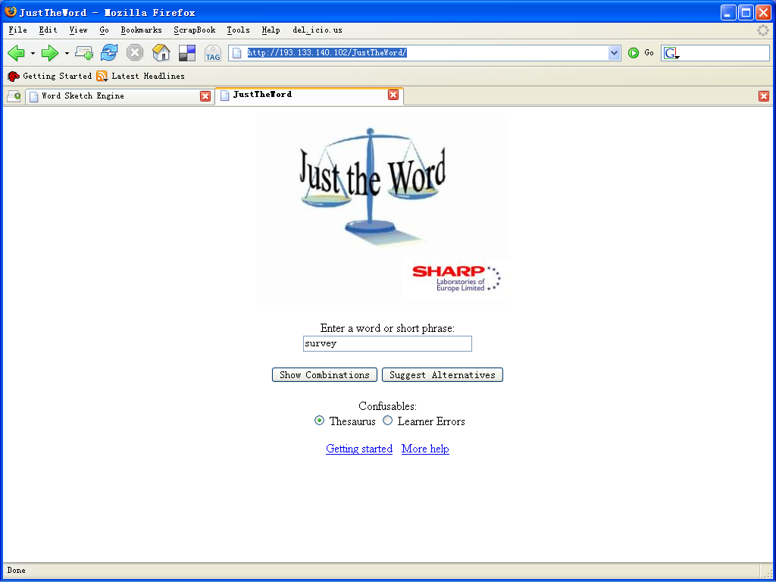
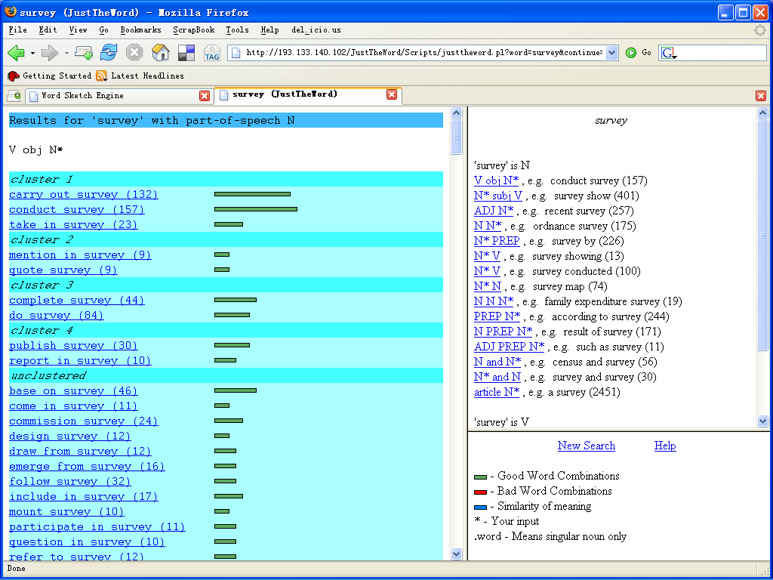
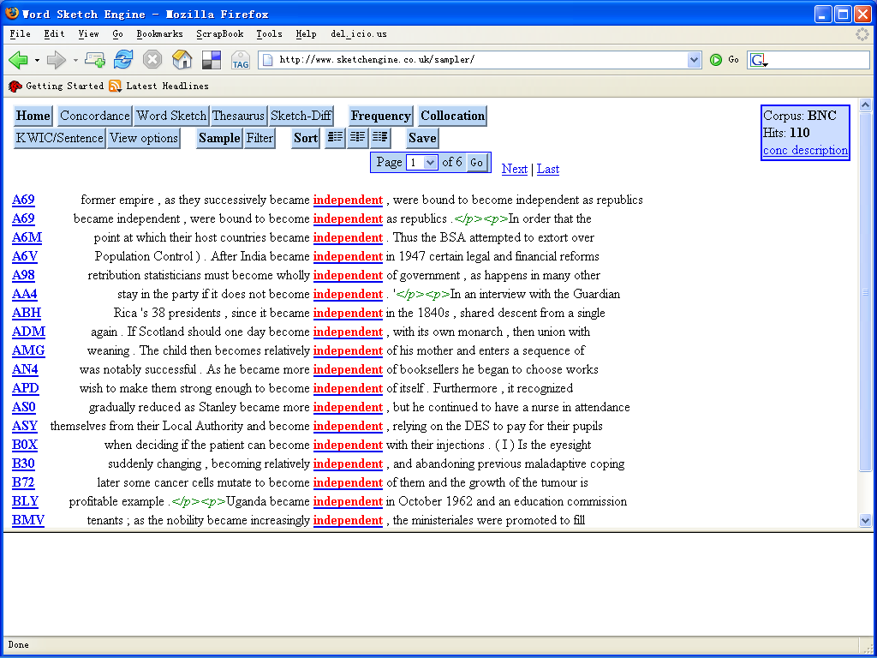
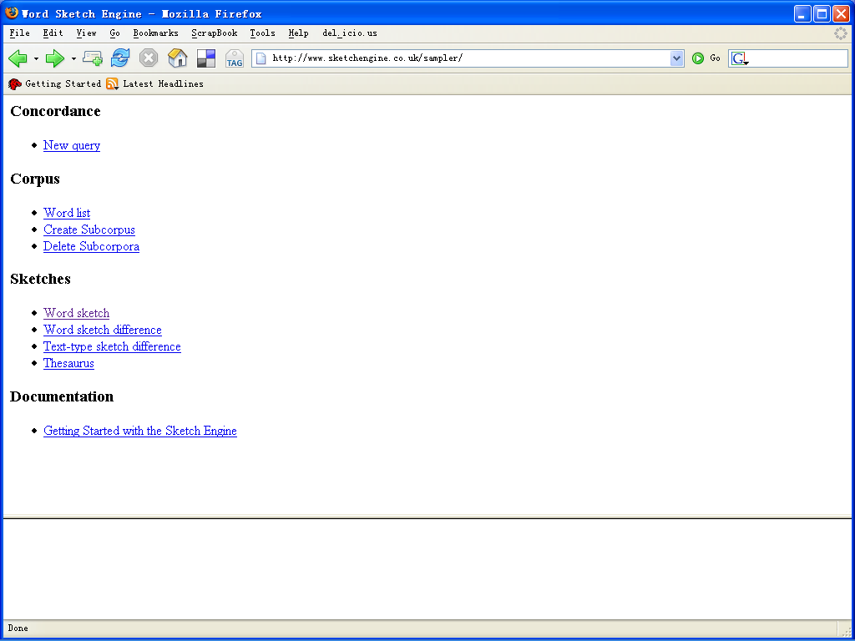
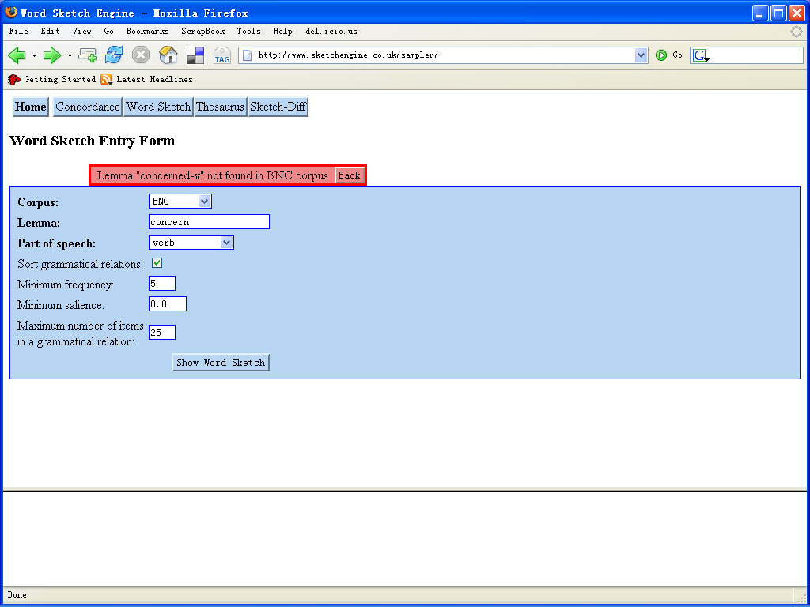
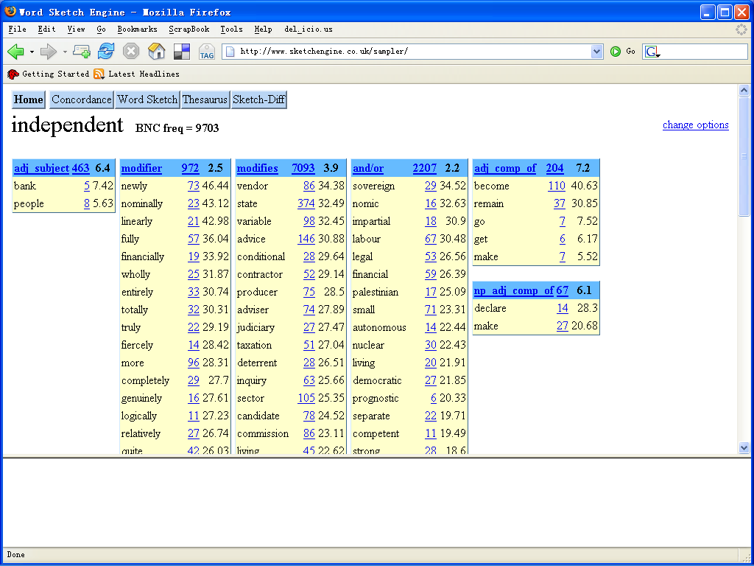
Collocations
collocation = the occurrence of two or more words within a short space of each other in text
the collocates are extracted using a window to the left and right of a specified word
can be used to further analyse the context of a word
http://www.sketchengine.co.uk/sampler/

Slide 25
What can we do with a corpus? －－Two broad approaches
Corpus-based approaches: hypotheses are checked against a corpus
Corpus-driven approaches: hypotheses are drawn from the corpus

Slide 26
Testing new hypothesis
Posit a hypothesis
Concordance
-le is a separate morpheme for the concept of future.
Find all occurrences of “le” in the wordforms of the corpus.
Test hypothesis

Slide 29
Fields where corpora are used
Lexicography to design dictionaries
Language studies (relations between languages, differences between genre, evolution of the language)
Computational linguistics (training and testing methods)
Language teaching (learner’s corpora)
Cultural studies, psycholinguistics

Slide 30
Web as a corpus
The Web can be very useful source of texts
The Web is very helpful for languages other than English
Quite often there is not control on the language which is investigated therefore filtering (if possible) is necessary

Slide 31
Existing corpora
Brown Corpus/LOB corpus
Bank of English
Wall Street Journal, Penn Tree Bank, BNC, ANC, ICE, WBE, Reuters Corpus
Canadian Hansard: parallel corpus English-French
York-Helsinki Parsed corpus of Old Poetry
Tiger corpus – German
CORII/CODIS - contemporary written Italian
MULTEX 1984 and The Republic in many languages
Almaty Corpus of Kazakh Langauge

Slide 32
References
Karin Aijmer and Bengt Altenberg (1991) English corpus linguistics, Longman
Duglas Biber, Susan Cnrad and Randi Reppen (1998) Corpus linguistics, Cambridge University Press
Graeme D. Kennedy (1998) An introduction to corpus linguistics, Longman
Tony McEnery and Andrew Wilson (1996) Corpus linguistics, Edinburgh University Press

Slide 33
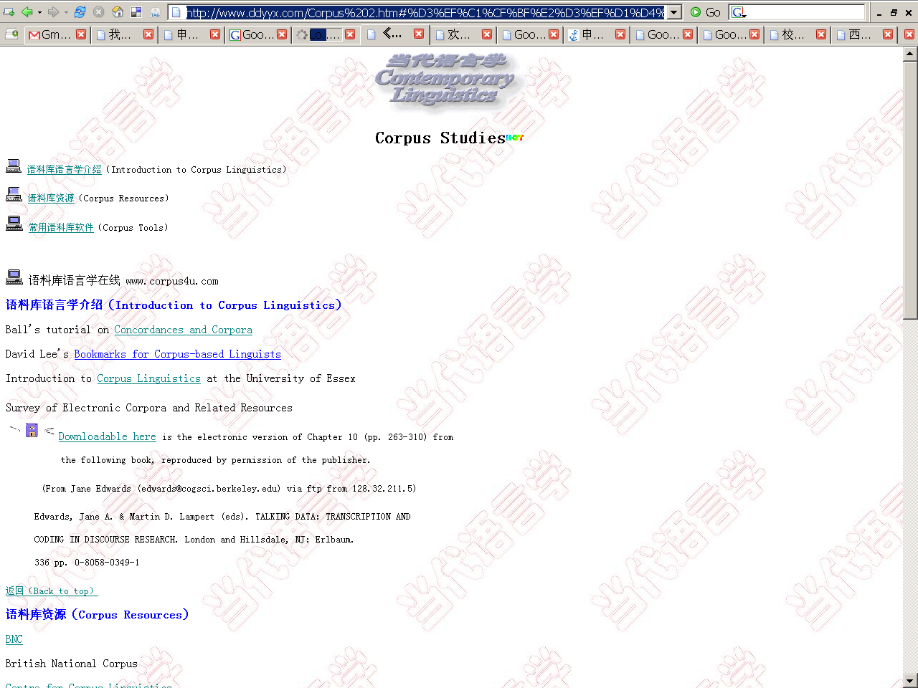
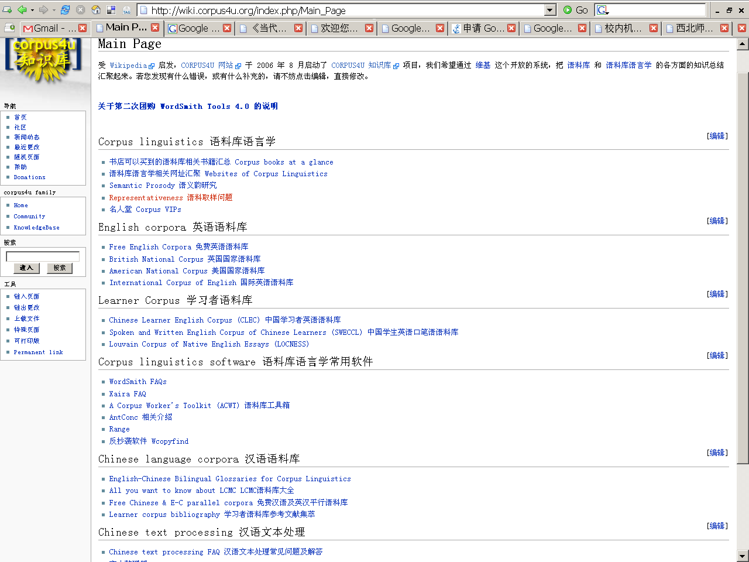
Online resources
语料库语言学在线
http://www.corpus4u.com/
语料库语言学与英语教育教学
http://sfs.scnu.edu.cn/corpus4u/
ConCapp
http://panda.nhce.edu.cn/corpus4u/tools/concord/wconcord.rar BNC：http://sara.natcorp.ox.ac.uk/lookup.html
CLEC: http://www.clal.org.cn/corpus/ChiSearchEngine.aspx
CHILDES: http://childes.psy.cmu.edu/

